Slide 1
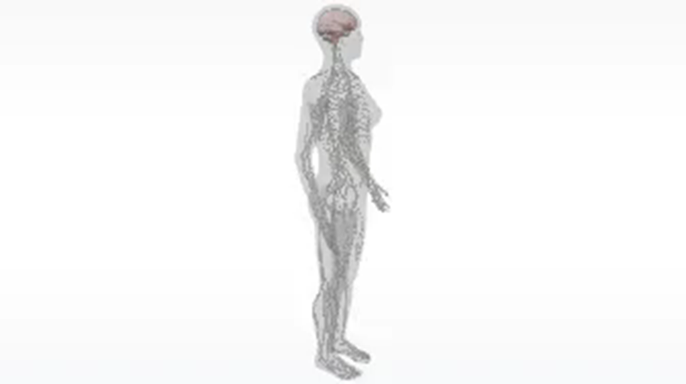
The Cerebrum
GTHBY
Year 12 General Human Biology

Slide 2
Review
Responsible for coordination and integration of sensory information with actions…
Made up of motor and sensory neurons…
Responsible for breathing and sleep…
The largest part of the brain…
Responsible for coordination and balance…

Slide 3
Review
6. The two branches of the autonomic peripheral nervous system…
7. Responsible for reflexes…
8. Consists of the brain and spinal cord…
9. The main function of the peripheral nervous system…
10. Responsible for cognitive function, motor and sensory function, speech and memory…

Slide 4
Learning Intentions
lobes of the brain – frontal, parietal, temporal, occipital
localisation of functions – Broca’s area, Wernicke’s area, pre-frontal cortex, primary motor cortex, primary sensory cortex, primary auditory cortex, primary visual cortex
Phineas Gage – case study illustrating localisation of lobe function

Slide 5
Success criteria
Name and label the lobes of the cerebrum (cerebral cortex) and specialised areas
Summarise the function of each lobe and specialised area.
Explain how Phineas Gage’s Case Study lead to improved understanding of brain function

Slide 6
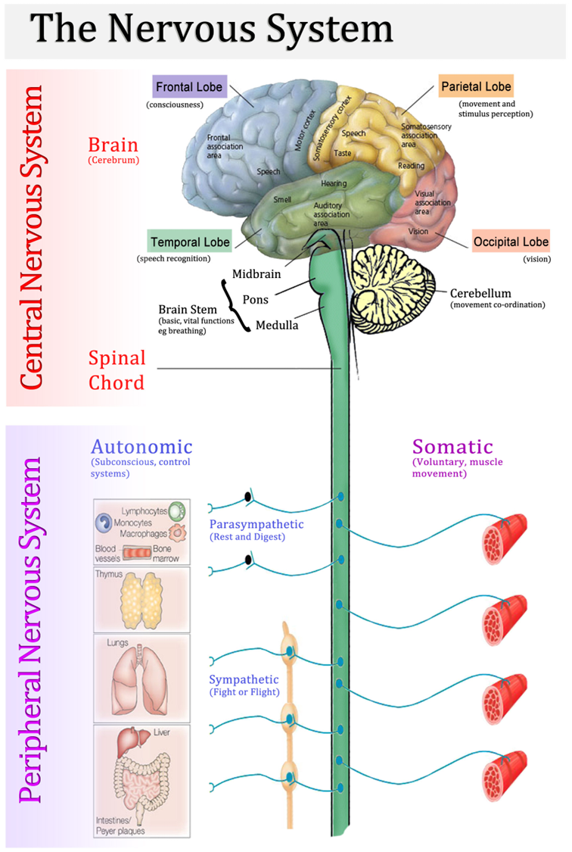
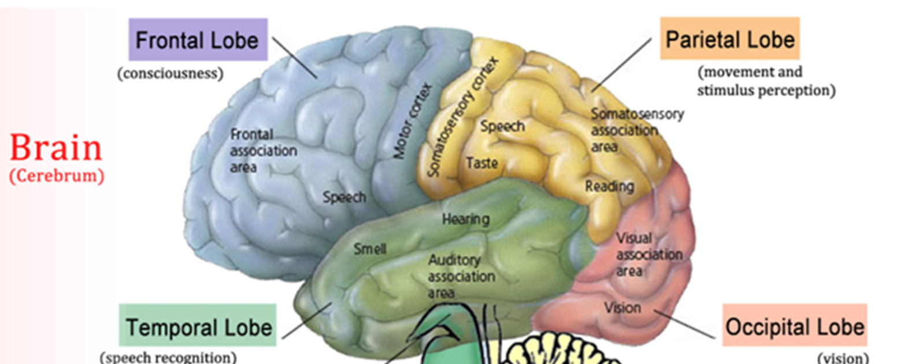

Slide 7
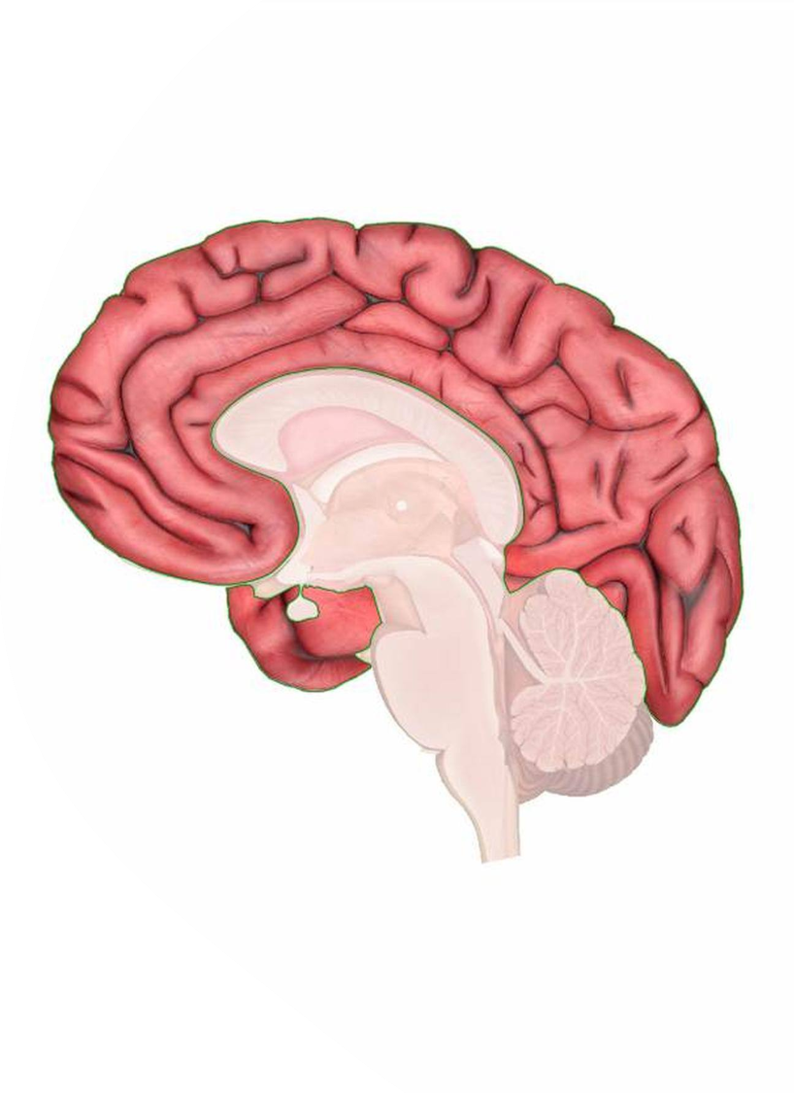
The cerebrum
The cerebrum is the largest and uppermost part of the brain and is also called the forebrain or cerebral cortex.
The cerebrum is made up of four lobes, each with different functions.

Slide 8
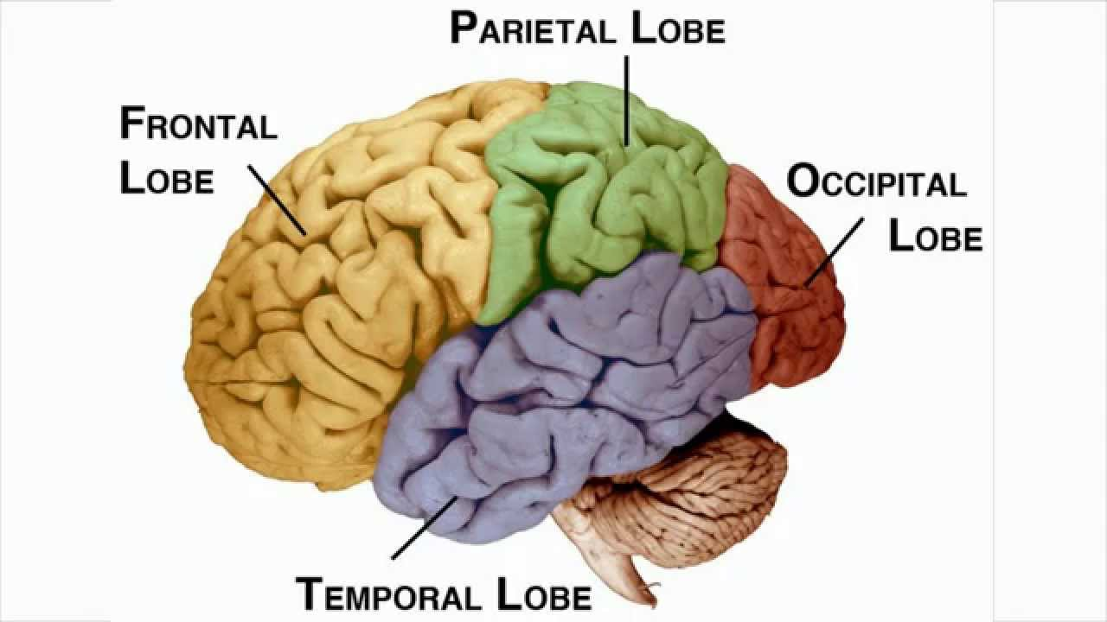

Slide 9
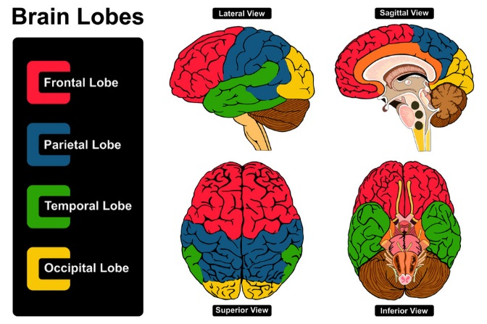

Slide 10
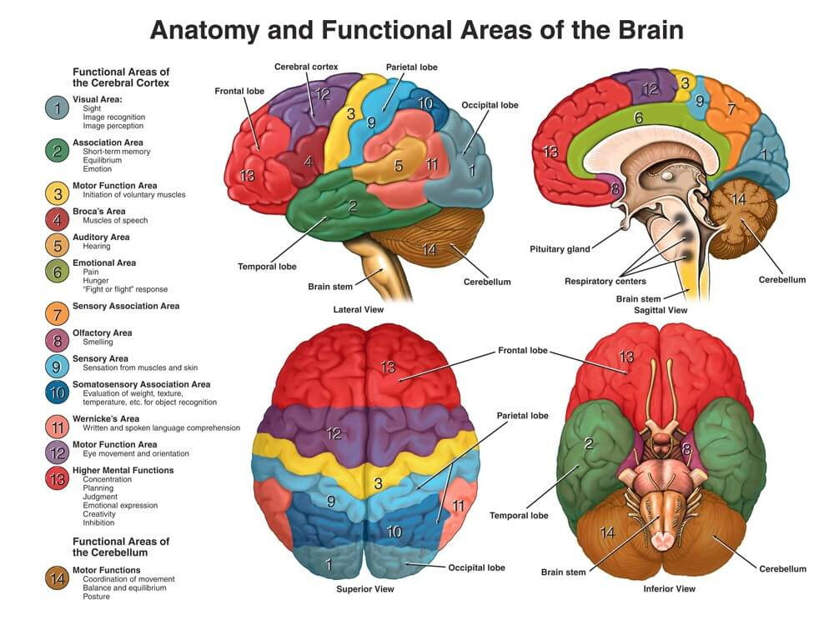

Slide 11
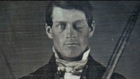

Slide 12
Success criteria
Name and label the lobes of the cerebrum (cerebral cortex) and specialised areas
Summarise the function of each lobe and specialised area.
Explain how Phineas Gage’s Case Study lead to improved understanding of brain function

